Slide 1
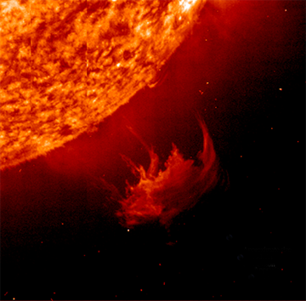

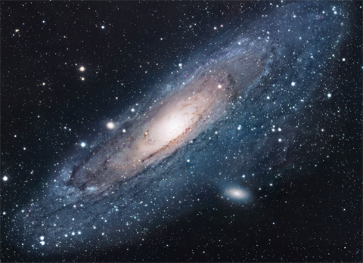

Slide 2
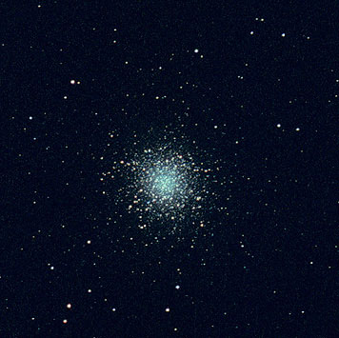
M13 Through the Telescope
M13 is 25,100 light years away from us.

Slide 3
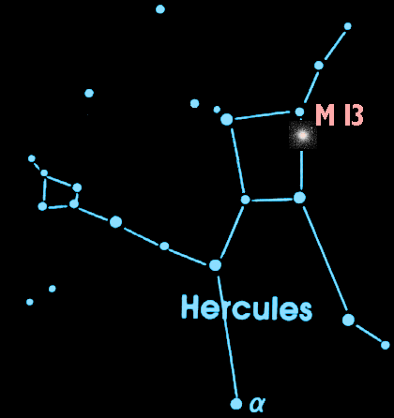
M13 is in the Night Sky
A dark night and a good pair of binoculars can help you catch a glimpse of this cluster of stars in the constellation Hercules.

Slide 4
What is M13?
M13 is a globular cluster over 150 light years across and it contains about 1,000,000 stars.

Slide 5
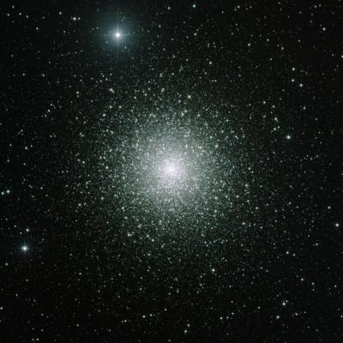
What is a Globular Cluster?
A globular cluster is a tightly packed group of about 100,000 stars. There are roughly 150-200 globular clusters in the Milky Way.

Slide 6
How Big are Globular Clusters?
150 light years
M13 is 150 light years across. At the speed of light (186,000 mi/sec) it takes 150 years for light to cross M13 from one side to the other. – That’s 2 lifetimes!

Slide 7
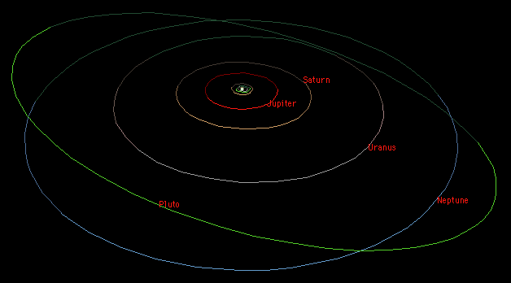
How Big !?
X 160,000 =
It would take 160,000 of our solar systems (as defined by Neptune’s orbit) placed side-by-side to stretch all the way across M13.

Slide 8
How Big !!!?
4 hrs 11 min.
It “only” takes light 4 hours 11 minutes to get from the Sun to Neptune.

Slide 9
How Old Are Globular Clusters?
The globular clusters of our Milky Way are old! They are the same age as the galaxy itself – at least 12 billion years old.

Slide 10
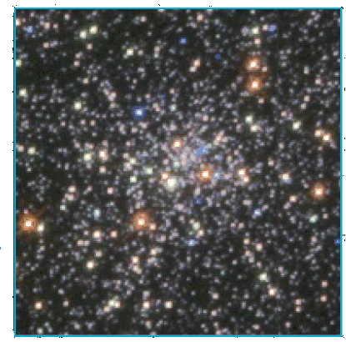
Young Stars in Old Clusters
This HST image reveals blue stars in a globular cluster's core.
Blue Stars do not live long. Globular clusters are old and generally do not have blue stars.
These blue stars may have been formed by
the collisions of old stars!

Slide 11
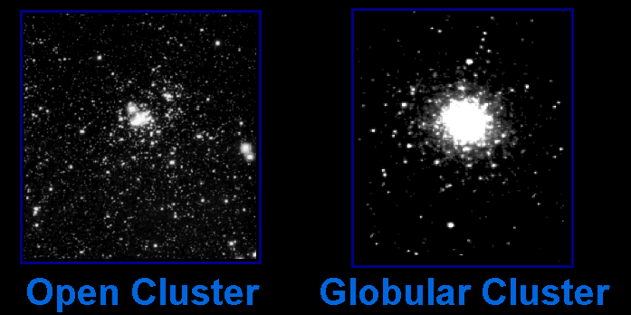
Star Clusters
There are two main types of star clusters in our Milky Way galaxy

Slide 12
Star Clusters
Star Clusters
Open clusters orbit within the disk of the galaxy while Globular clusters orbit above and below the plane of the galaxy in the galactic halo.

Slide 13
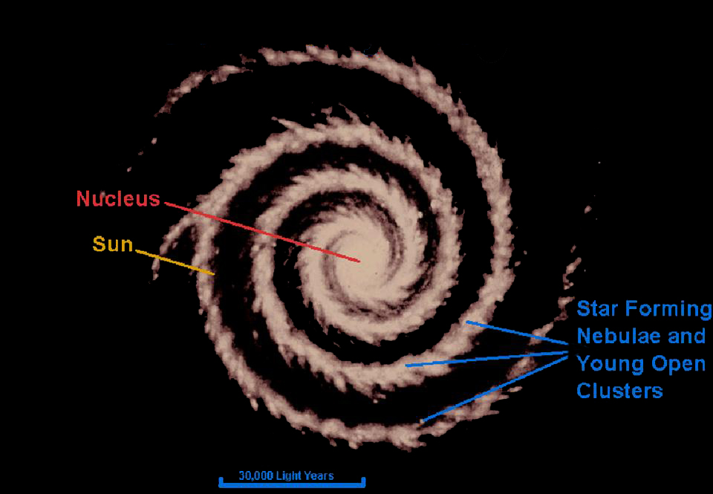
Our Milky Way Galaxy
(top view)

Slide 14
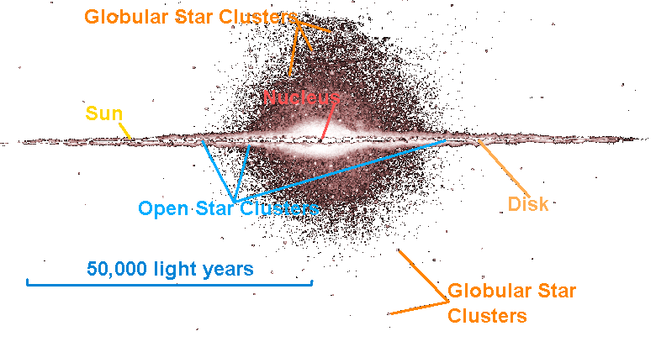
Our Milky Way Galaxy
(side view)

Slide 15
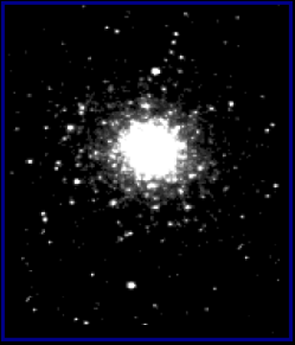

The Star Clusters Are Actually Different Sizes
Open Cluster
Globular Cluster
Open clusters are about 30 light years across.
Globular clusters are about 150 light years across.
Open clusters are 5 times smaller than globular clusters. They only look the same size because they are closer.

Slide 16
The Star Clusters Are Actually Different Sizes
Open Cluster
Globular Cluster
Open clusters have hundreds to thousands of stars.
Globular clusters have thousands to nearly a million stars.

Slide 17
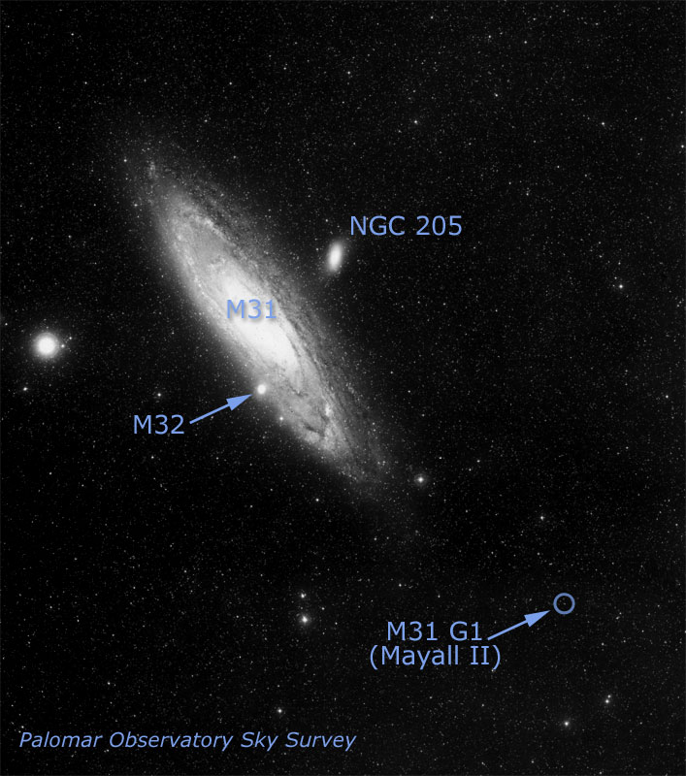
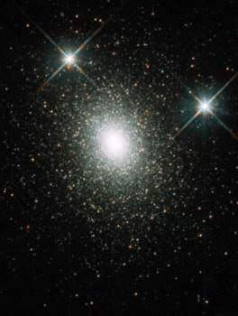
Other Galaxies Have Halos of Globular Clusters
HST image of G1
This globular cluster called G1 is in the halo of the Andromeda galaxy (M31).
This globular has a medium-sized black hole in it!

